Slide 1
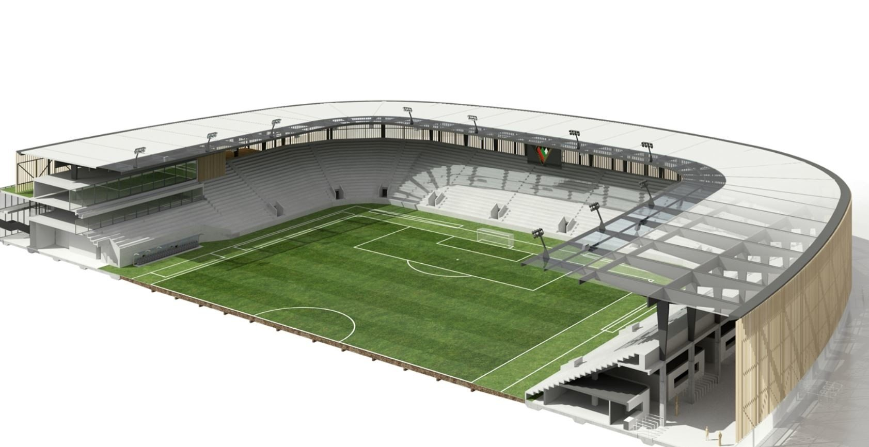
Notes:
These images are for instructional educational purposes only to be used in the fictious design and deployment of a theoretical network.

Slide 2
Notes:
These images are for instructional educational purposes only to be used in the fictious design and deployment of a theoretical network.

Slide 3
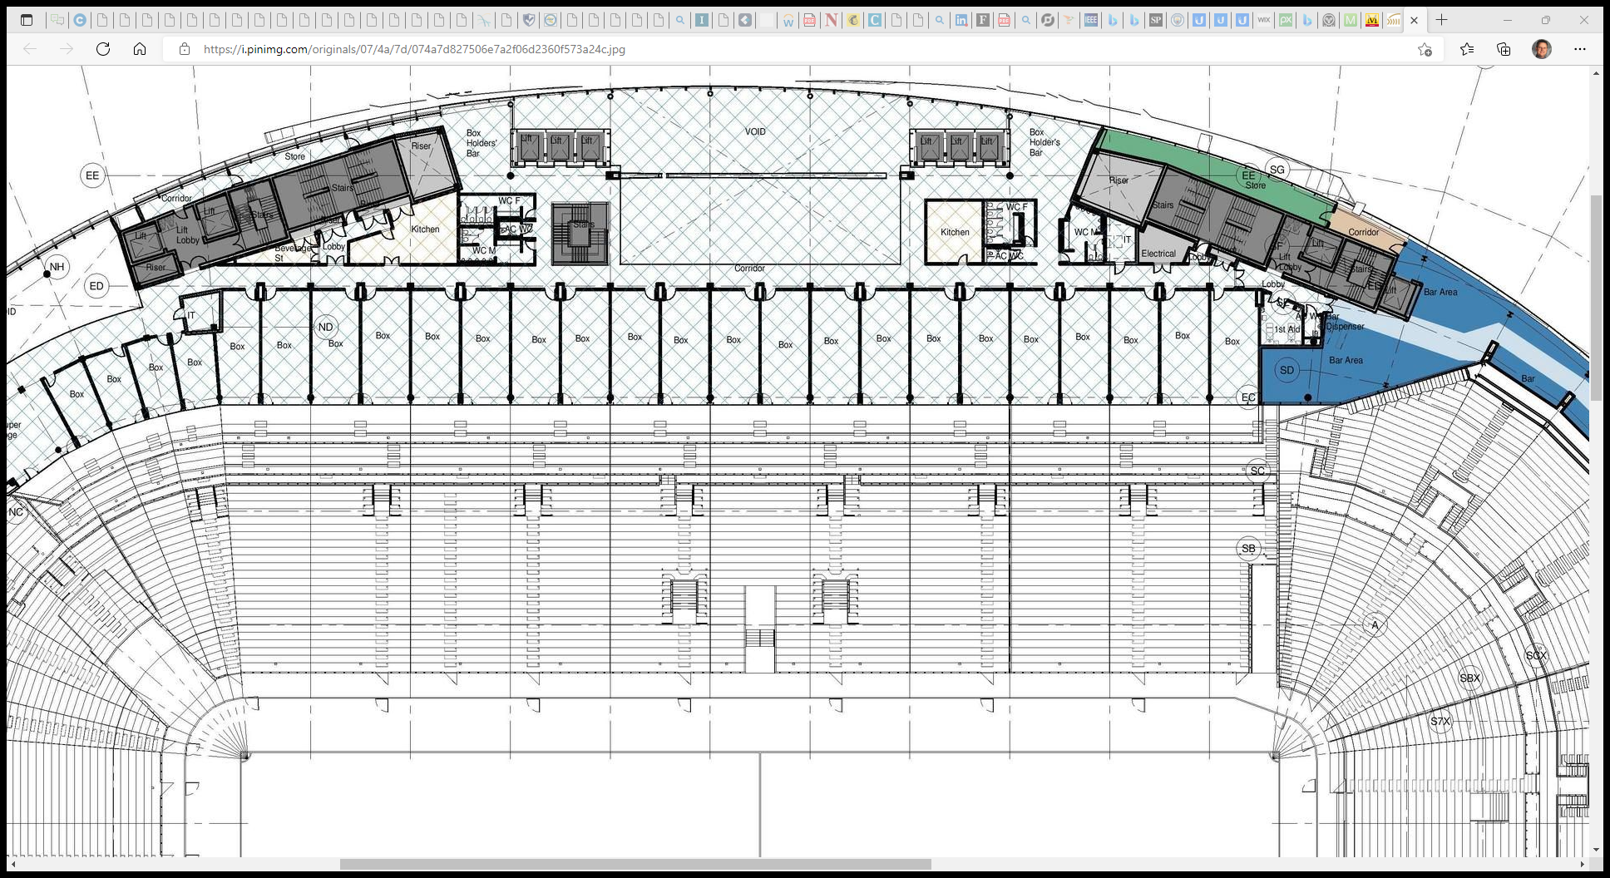
These images are for instructional educational purposes only to be used in the fictious design and deployment of a theoretical network.
Notes:
These images are for instructional educational purposes only to be used in the fictious design and deployment of a theoretical network.

Slide 4
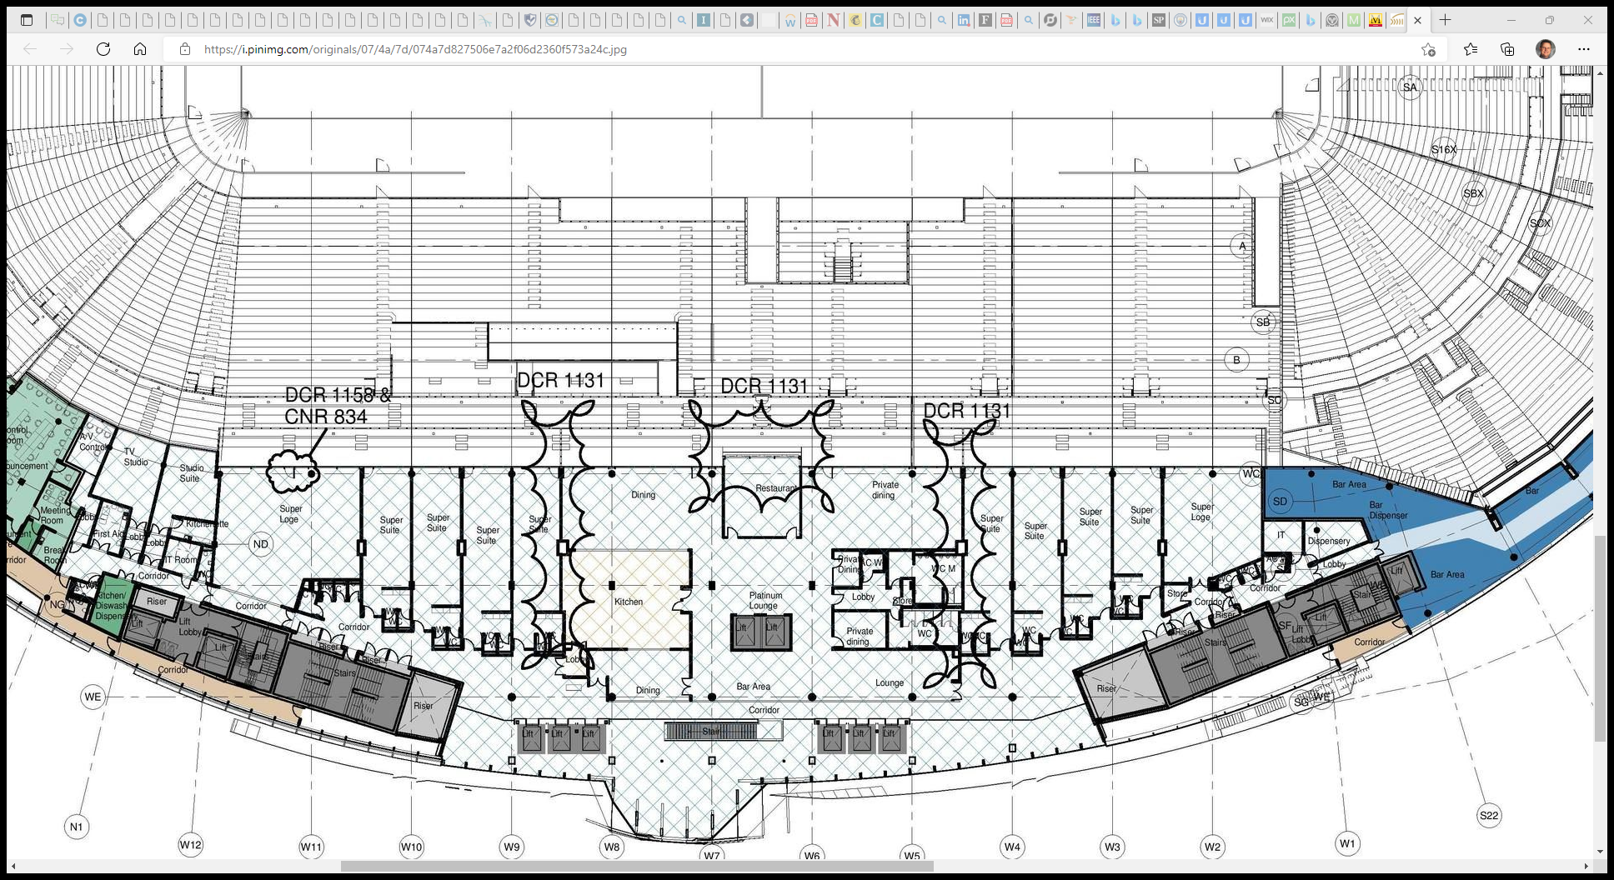
Notes:
These images are for instructional educational purposes only to be used in the fictious design and deployment of a theoretical network.

Slide 5
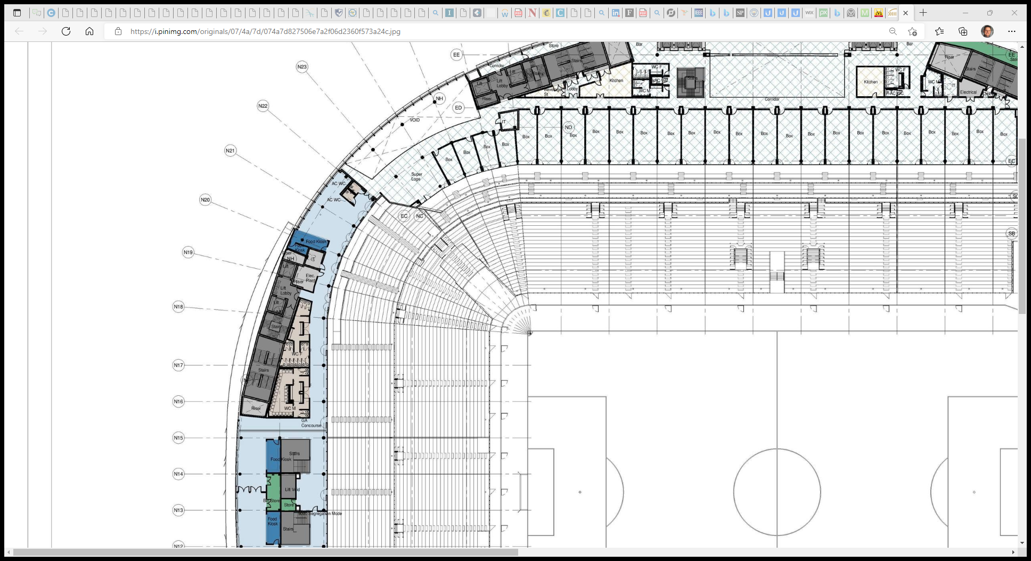
Notes:
These images are for instructional educational purposes only to be used in the fictious design and deployment of a theoretical network.

Slide 6
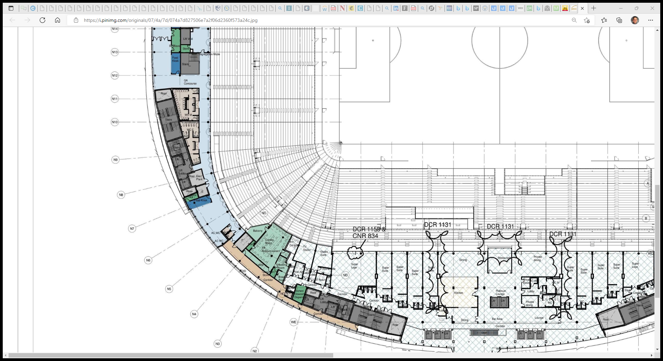
Notes:
These images are for instructional educational purposes only to be used in the fictious design and deployment of a theoretical network.

Slide 7
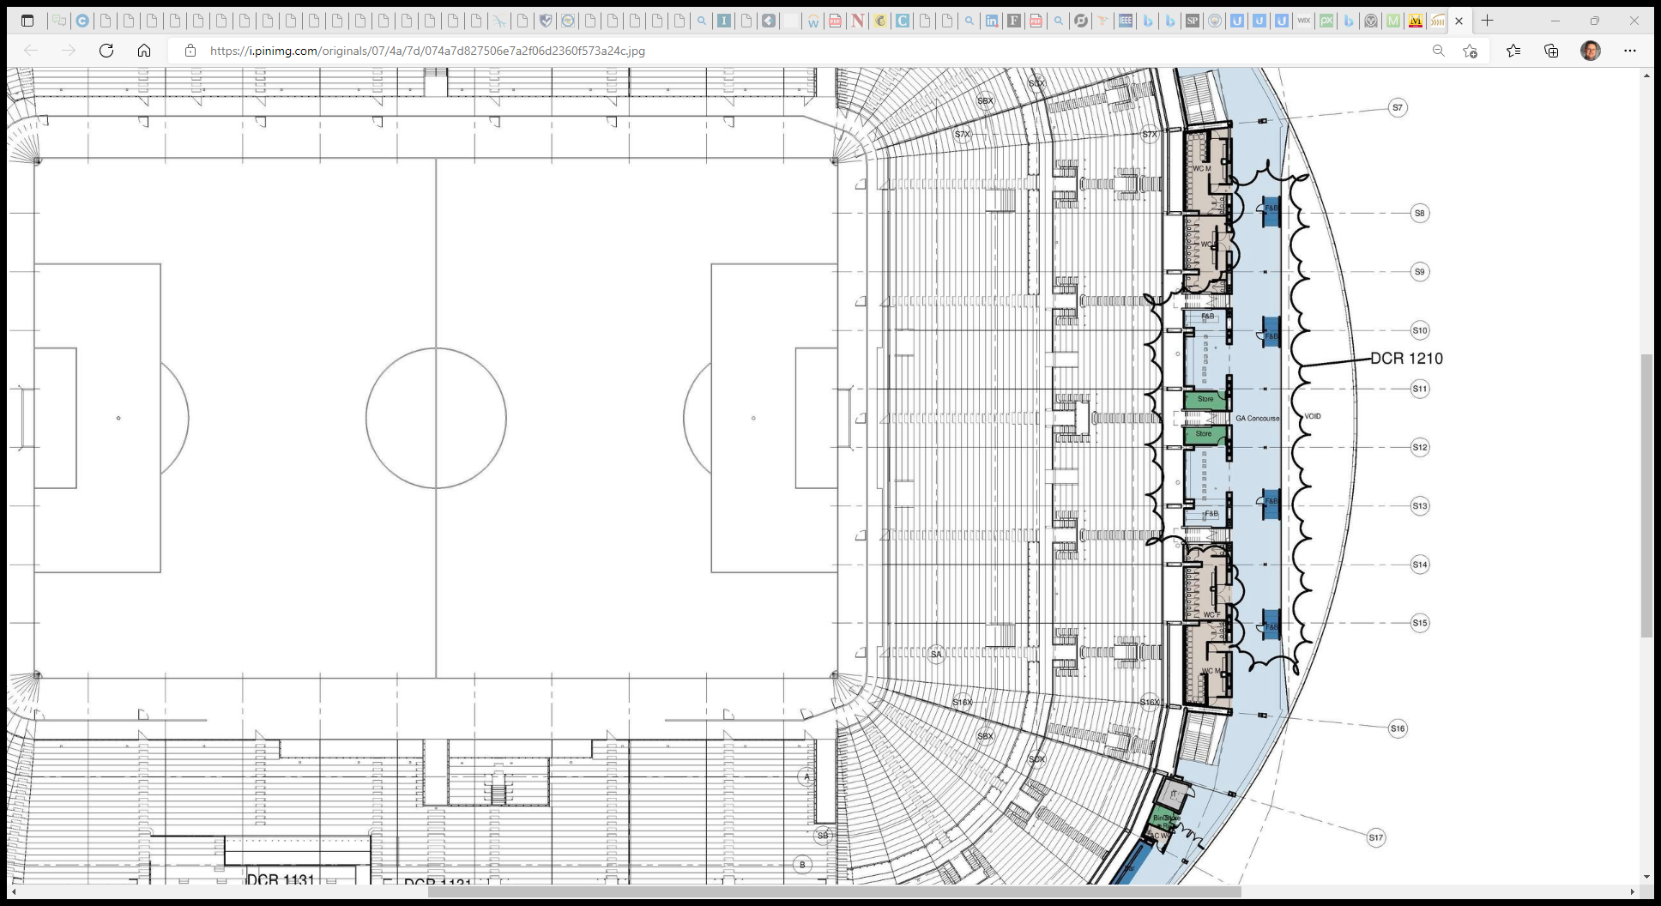
Notes:
These images are for instructional educational purposes only to be used in the fictious design and deployment of a theoretical network.

Slide 8
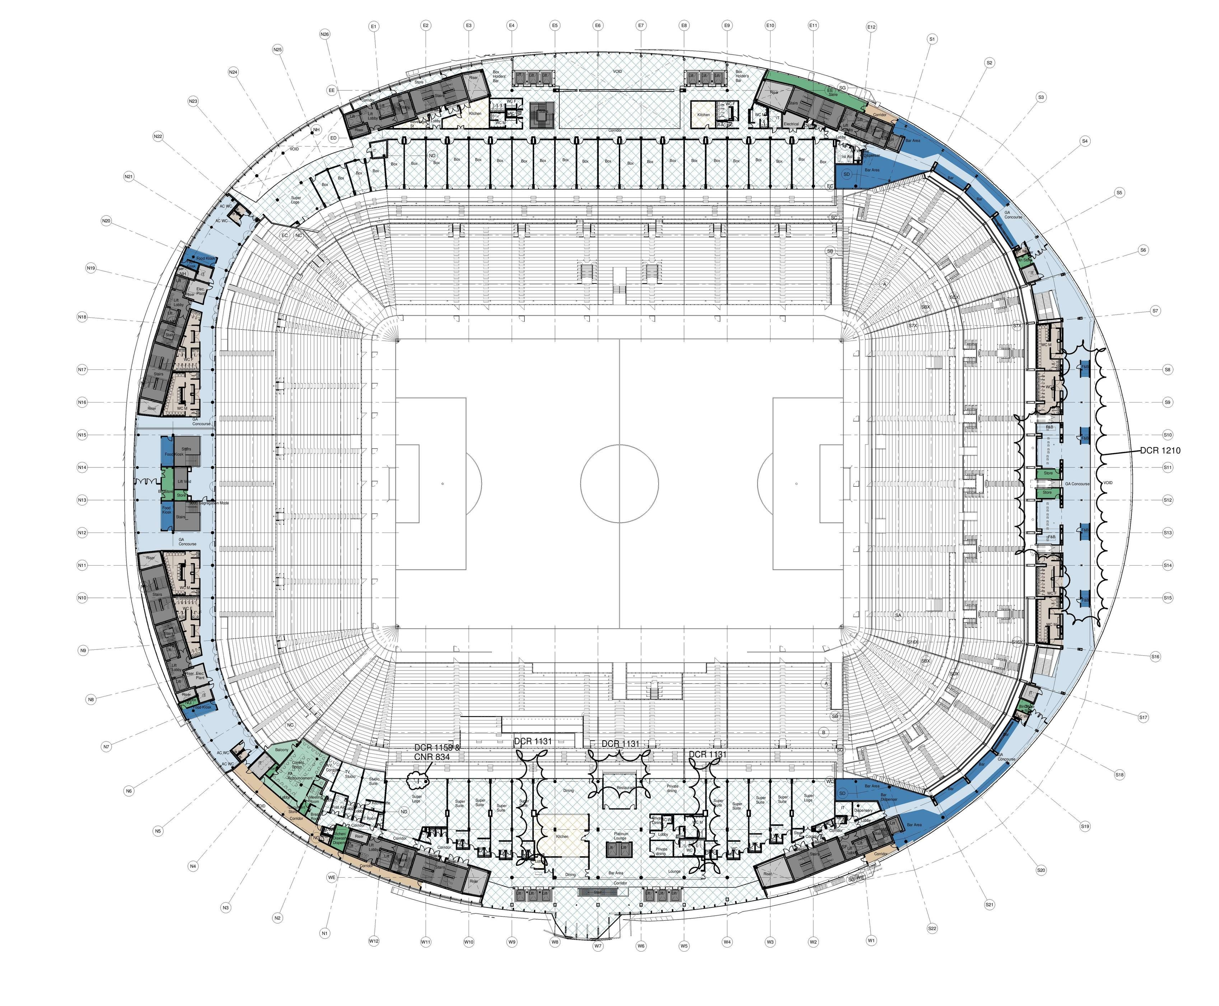
Notes:
These images are for instructional educational purposes only to be used in the fictious design and deployment of a theoretical network.

